Slide 1


SERVICE REQUEST AND WORKFLOW AUTOMATION
BACHELOR OF TECHNOLOGY IN
DEPARTMENT OF ARTIFICIAL INTELLIGENCE AND MACHINE LEARNING
Academic Year: 2025-2026
Developed by: Batch 10
V. V.P.S Sahithi -22221 A6155
K.Yaswanth durgendra -22221A6123
P. M.S.Seshagiri -22221A6146
K. Jagan satya sai -23225A6103
  Under the esteemed guidance of
  G. Lakshmi, M.Tech
  Assistant Professor – Dept of CSE Allied-AIML
BONAM VENKATA CHALAMAYYA ENGINEERING COLLEGE
(AUTONOMOUS)
(Approved by AICTE, New Delhi, Permanently affiliated to JNTUK, Kakinada) (An ISO 9001:2015 Certified Institute, Accredited by NBA and NAAC with ‘A’ Grade)
ODALAREVU - 533210

Slide 2

Abstract
The Service Request and Workflow Automation System is a web-based application developed to improve organizational efficiency by automating service request processes such as submission, approval, assignment, and resolution. The system enables users to raise service requests online and track their status in real time. By automating workflows, it reduces manual effort and operational delays while enhancing service quality. The application provides role-based interfaces for users, service staff, and administrators. Users can submit and monitor requests, while service staff manage assigned tasks efficiently. Administrators can configure workflows, monitor system performance, and generate reports. The system is built using modern full-stack technologies to ensure scalability, security, and reliability.

Slide 3
Existing System
In the existing system, service requests are mostly handled using manual methods such as emails, phone calls, and paper forms. There is no centralized platform to register and manage all service requests. Users must repeatedly follow up to know the status of their requests. Approval processes are slow because they depend on manual communication. Delays are common when requests are forwarded to the wrong department. There is a high chance of requests being missed or forgotten. Maintaining records manually is time-consuming and inefficient. Data redundancy and inconsistency often occur. Communication gaps cause dissatisfaction among users. There is no real-time notification system for updates. Security of sensitive information is weak. Overall efficiency is low and operational costs are high. The existing system fails to meet modern organizational service management needs.

Slide 4
Proposed System
The proposed system provides a centralized and automated platform for managing service requests. Users can submit service requests through an online interface. Each request is automatically categorized and assigned to the appropriate department. Predefined workflows control the flow of tasks and approvals. The system reduces manual intervention and speeds up processing time. Automated notifications keep users informed about request status. Real-time tracking improves transparency and accountability. Approval processes become faster and more reliable. The system stores all request data in a secure database. Managers can monitor workload and performance easily. Reports and analytics help in decision-making. Error rates are reduced through automation. The system supports escalation of unresolved requests. Role-based access improves security. The platform is scalable to handle increased request volumes

Slide 5
Technology Stack
Frontend: CSS, HTML, JavaScript
Backend: Java (Spring Boot).
Database: MySQL (Relational Database Management System)
Security: JWT (JSON Web Tokens), Spring Security
Build Tools: Maven (Backend), Vite/npm (Frontend)
System Requirements
Hardware: PC / Laptop (Minimum 8GB RAM, i5 Processor recommended)
Software: Java JDK 17+, MySQL Workbench, VS Code.

Slide 6
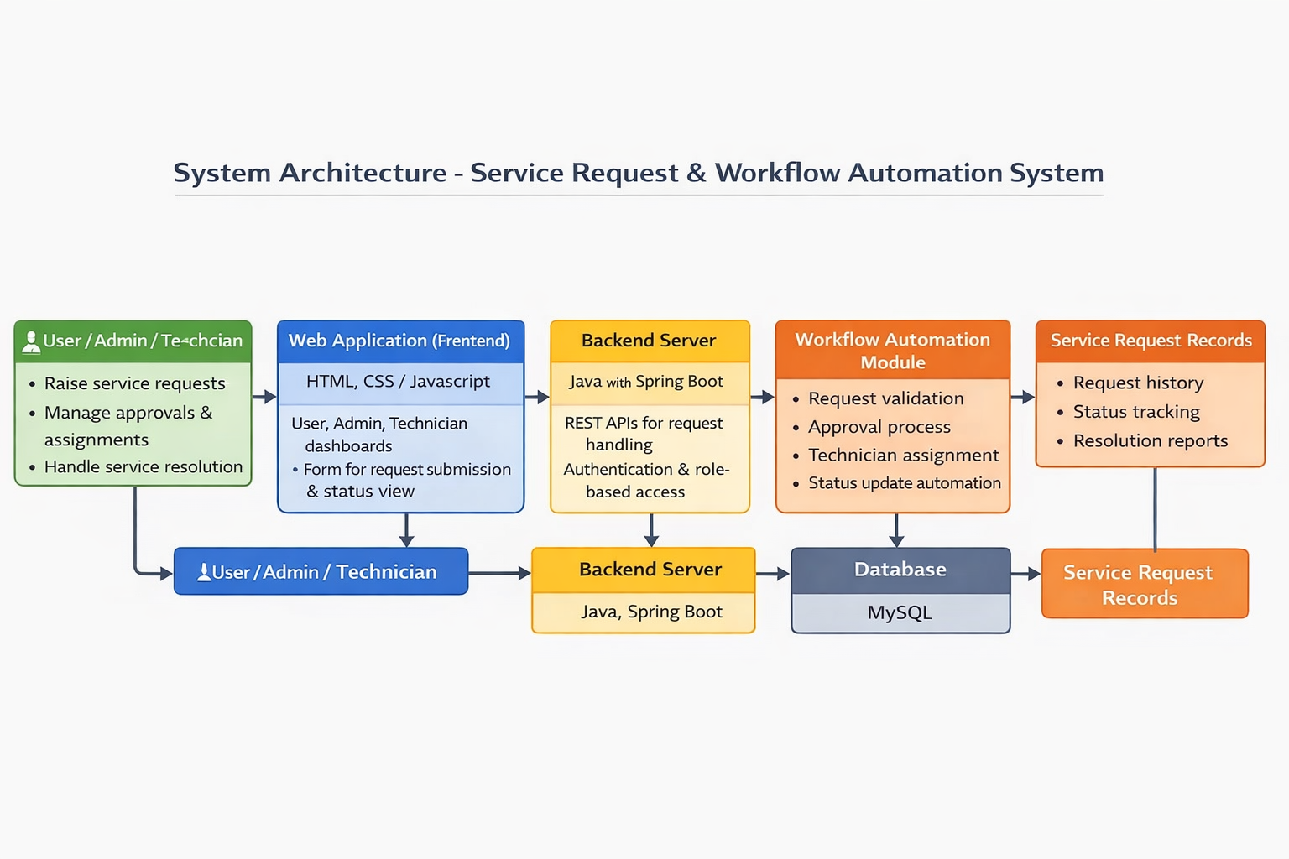

Slide 7
Objectives​
Automate Service Request Processing:
To fully automate the service request lifecycle, from request creation to approval, assignment, and resolution.
Reduce Manual Work & Errors:
To minimize manual intervention in service handling, thereby reducing human errors and improving accuracy.
Provide Secure Role-Based Access:
To implement a secure system with role-based access for users, administrators, and technicians.
Ensure Faster & Efficient Service Delivery:
To provide timely service resolution through automated workflows and real-time status updates.

Slide 8
Literature Review​​
​
Traditional service request handling systems rely heavily on manual processes such as emails, phone calls, and paper records.
Manual service management leads to delays, lack of proper tracking, and higher chances of human errors.
Workflow automation systems help in streamlining request approval, assignment, and resolution processes.
Centralized databases improve data consistency, security, and efficient record management.
Web-based service management systems enable faster access, real-time tracking, and better decision-making.

Slide 9
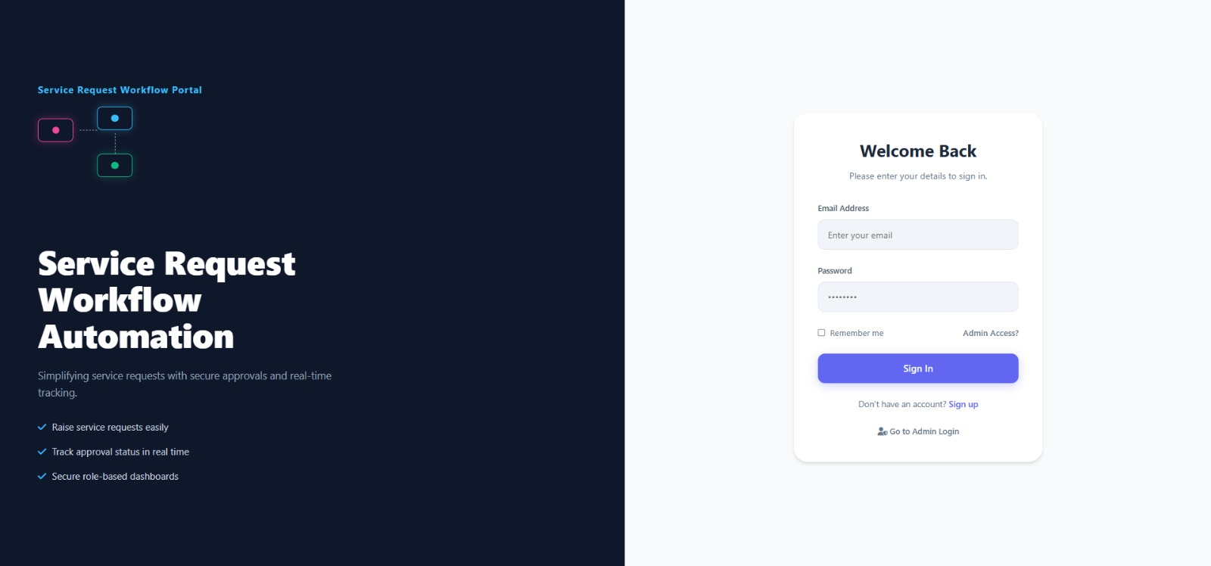
User Login Page

Slide 10
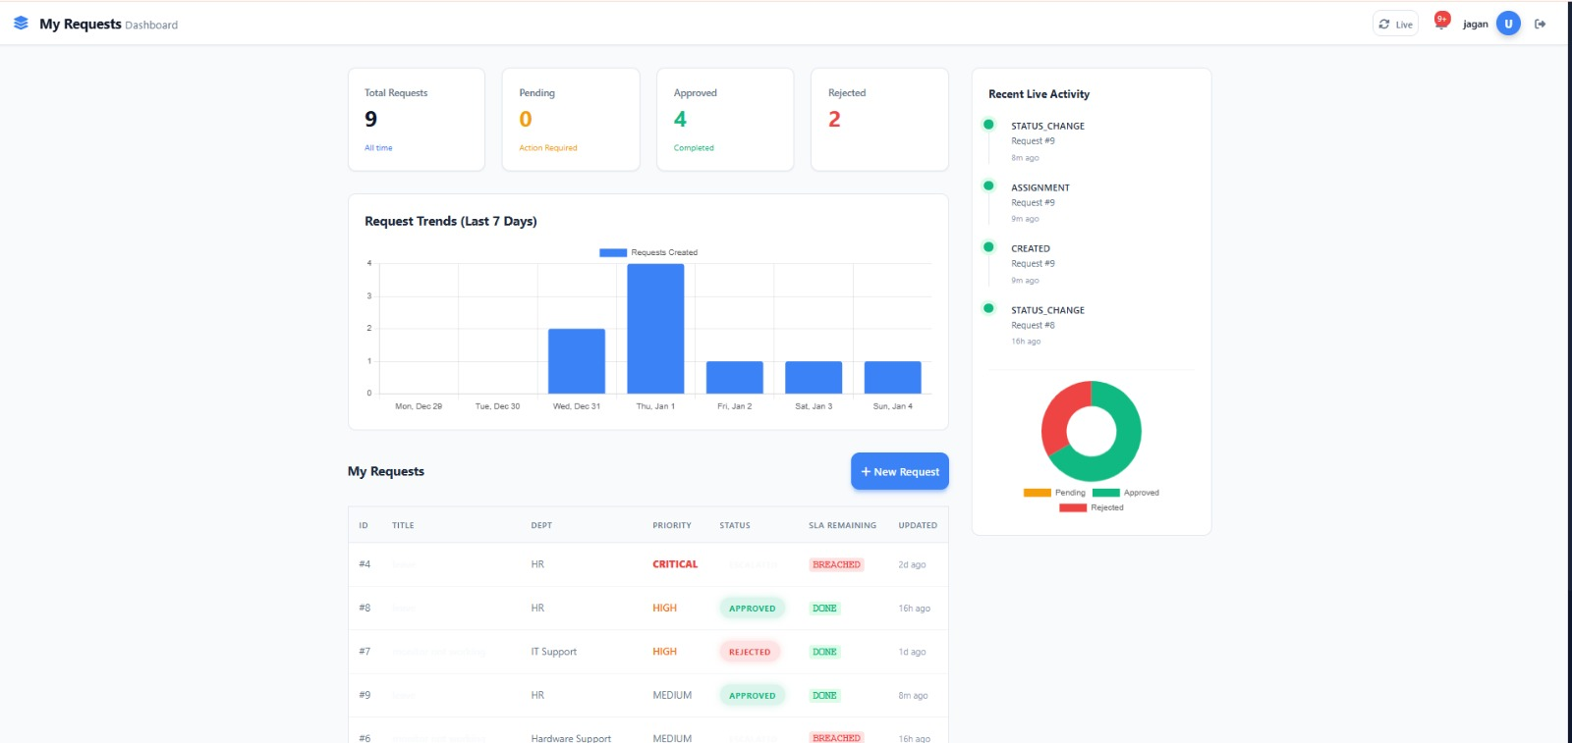
User Interface

Slide 11
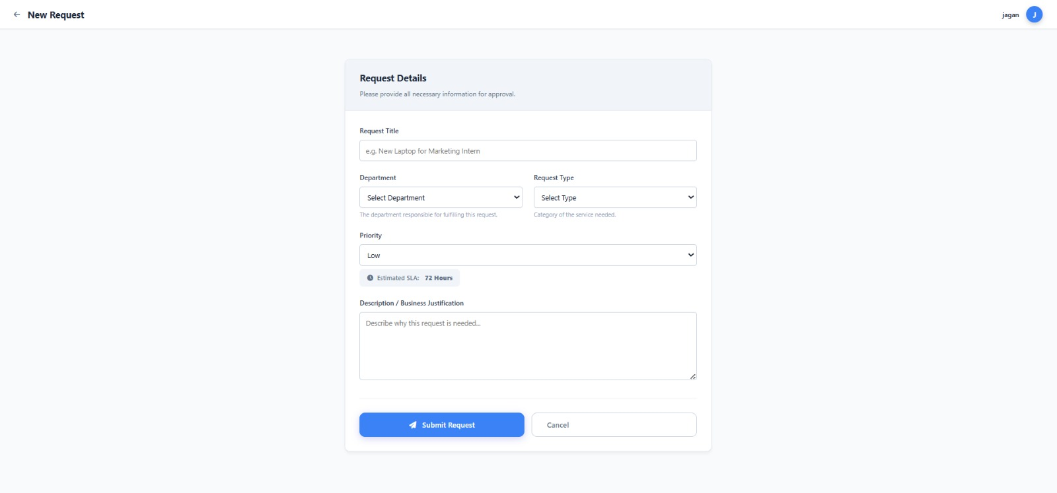
Request Page

Slide 12
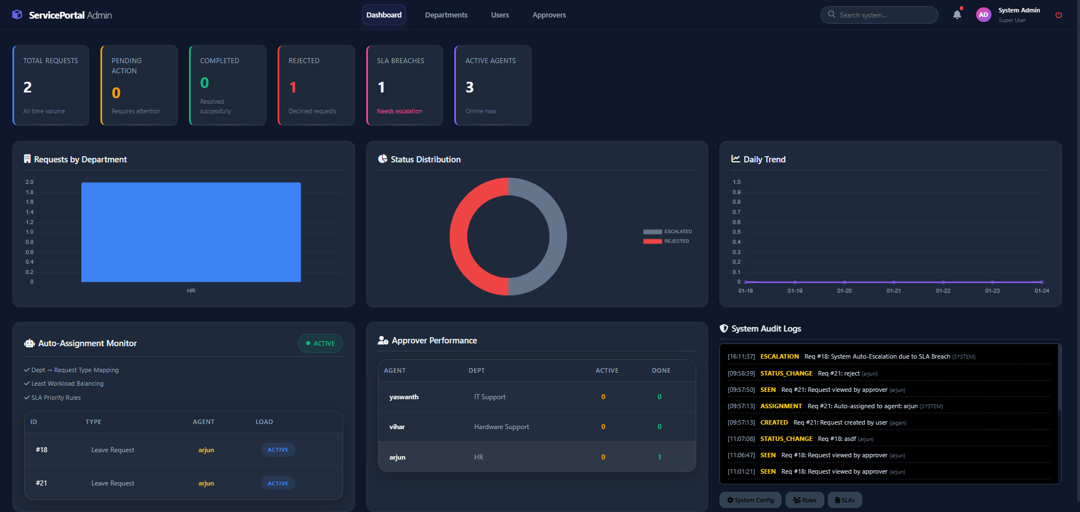
Admin Dashboard

Slide 13
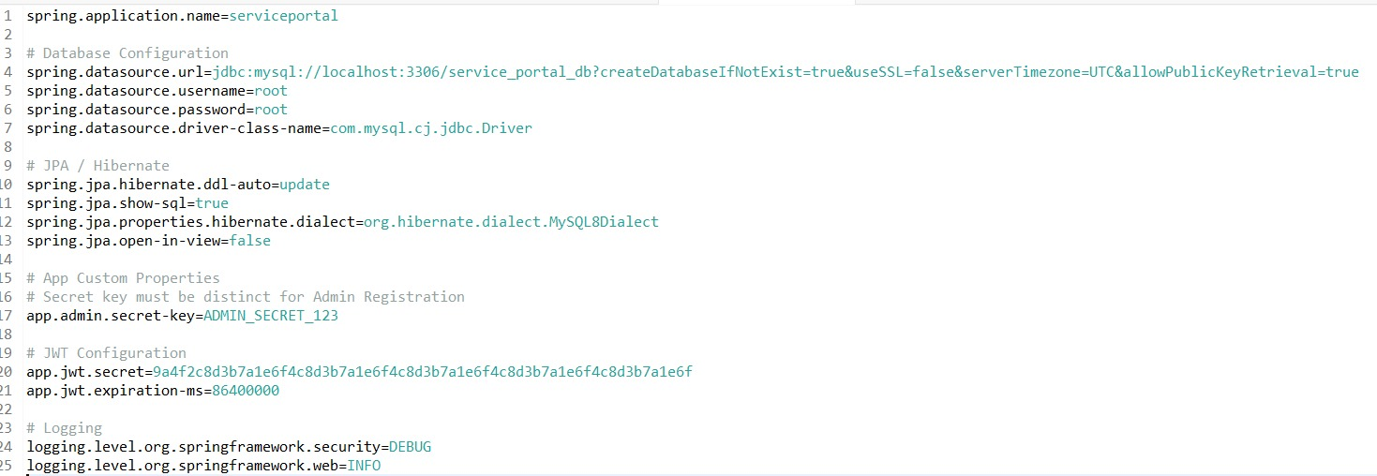
Project code
​

Slide 14
Thank You

